Slide 1
CSE 408 Data Mining
Automobiles Data Analysis
To
Prof. Viswanathan V
V Jai Prashanth 14BCE1019
K Akhil Reddy 14BCE1222

Slide 2
Data Content
This data set consists of three types of entities:
(a) the specification of an auto in terms of various characteristics,
(b) its assigned insurance risk rating,
(c) its normalized losses in use as compared to other cars. The third factor is the relative average loss payment per insured vehicle year. This value is normalized for all autos within a particular size classification (two-door small, station wagons, sports/speciality, etc...), and represents the average loss per car per year.

Slide 3
Objectives
To classify the cars based on the Risk Factor involved and the Normalized Losses of a each automobile.
To predict the Engine Size using linear multiple Regression with attributes.

Slide 4
K-Means Algorithm
K-Means Clustering
K-Means clustering intends to partition n objects into k clusters in which each object belongs to the cluster with the nearest mean. This method produces exactly k different clusters of greatest possible distinction. The best number of clusters k leading to the greatest separation (distance) is not known as a priori and must be computed from the data.
The objective of K-Means clustering is to minimize total intra-cluster variance, or, the squared error function:

Slide 5
Regression Techniques
Multiple Linear Regression
Regression is a data mining technique used to predict a range of numeric values (also called continuous values), given a particular dataset. For example, regression might be used to predict the cost of a product or service, given other variables.
Regression is used across multiple industries for business and marketing planning, financial forecasting, environmental modeling and analysis of trends.

Slide 6
Attributes
Symboling
This rating corresponds to the degree to which the auto is more risky than its price indicates. Cars are initially assigned a risk factor symbol associated with its price. Then, if it is more risky (or less), this symbol is adjusted by moving it up (or down) the scale. Actuarians call this process "symboling".
A value of +3 indicates that the auto is risky, -3 that it is probably pretty safe.

Slide 7
Bore is the diameter of each cylinder.
stroke is the length that it travels when moving from bottom position to the top position.
The static compression ratio of an internal combustion engine or external combustion engine is a value that represents the ratio of the volume of its combustion chamber from its largest capacity to its smallest capacity. It is a fundamental specification for many common combustion engines.

Slide 8
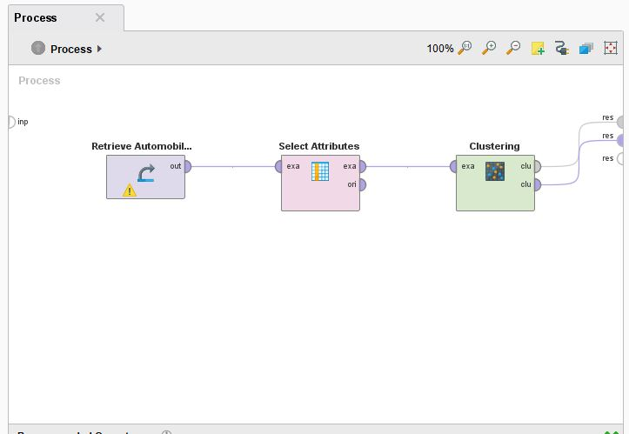
Clustering

Slide 9
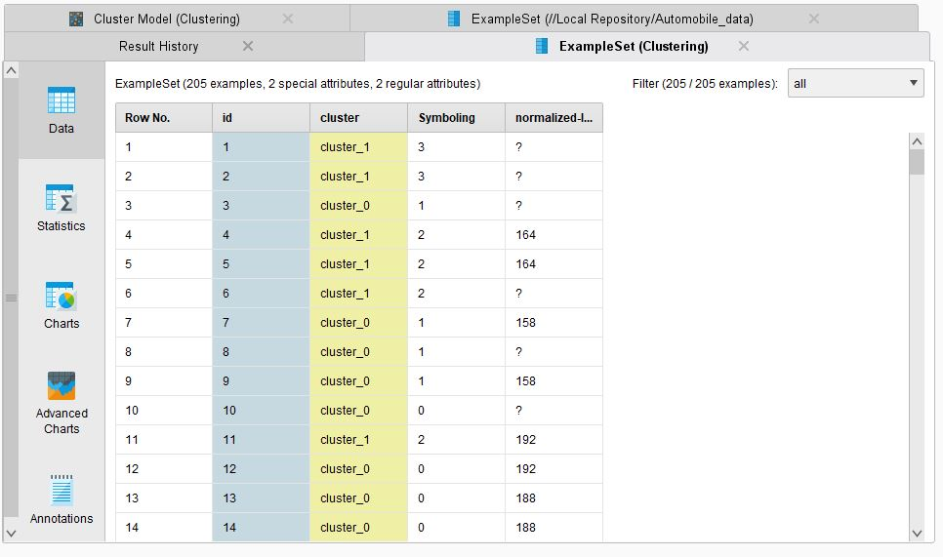

Slide 10
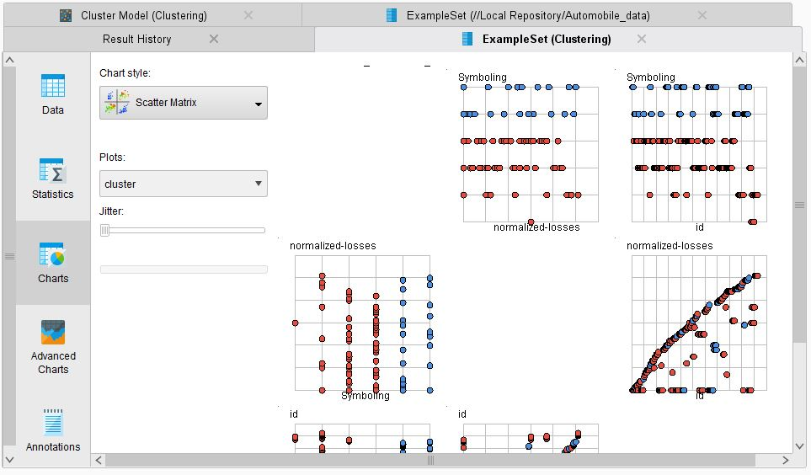

Slide 11
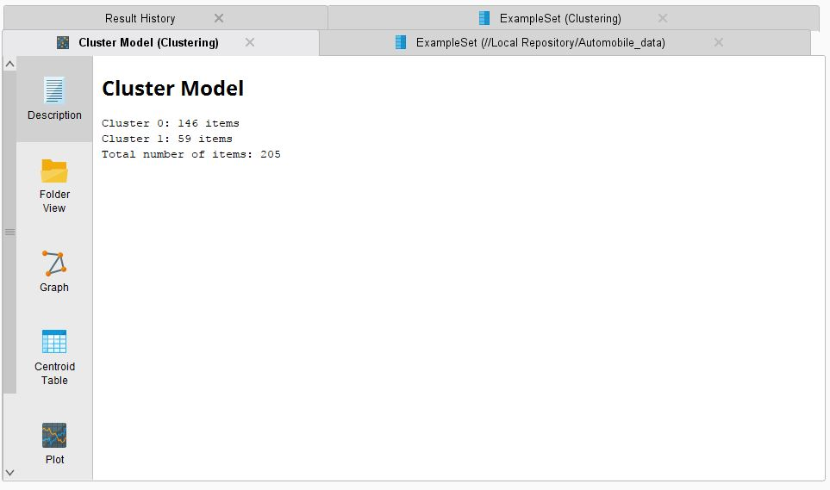

Slide 12
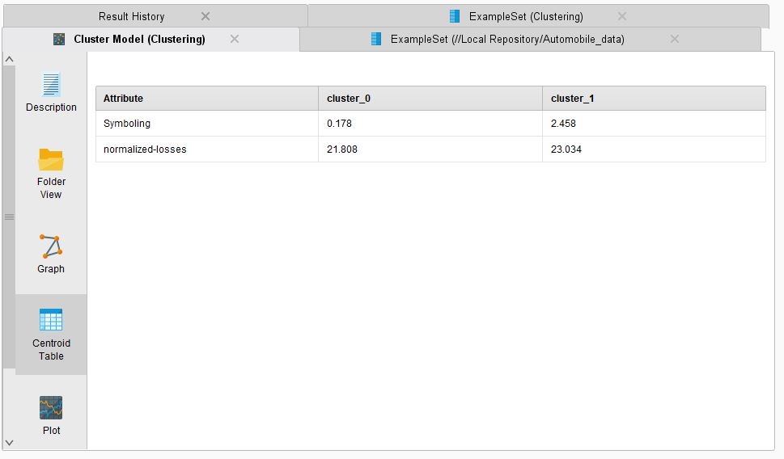

Slide 13
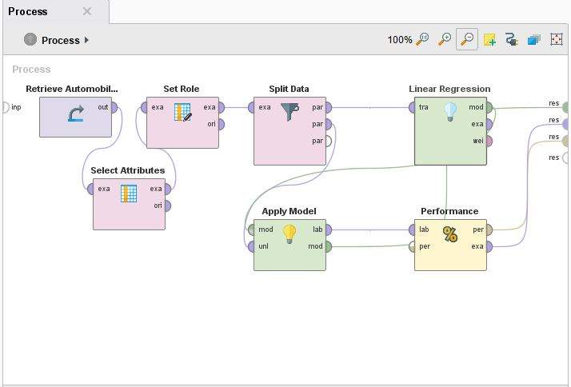
Regression

Slide 14
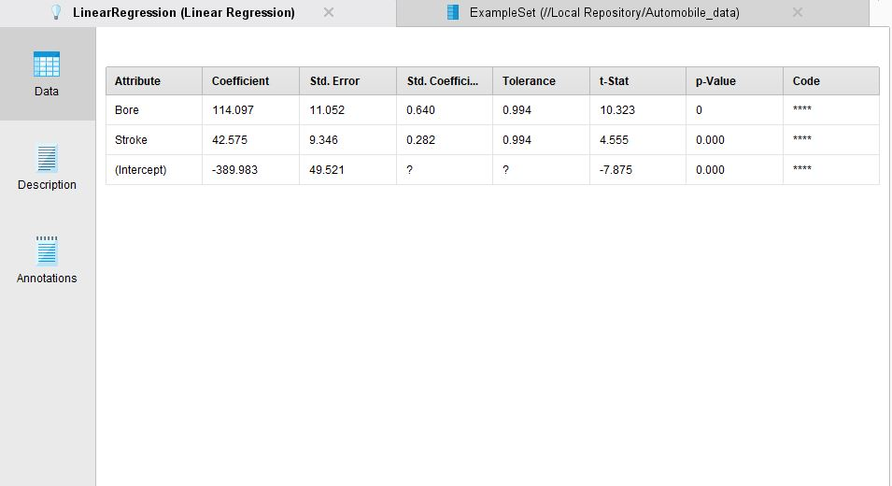

Slide 15
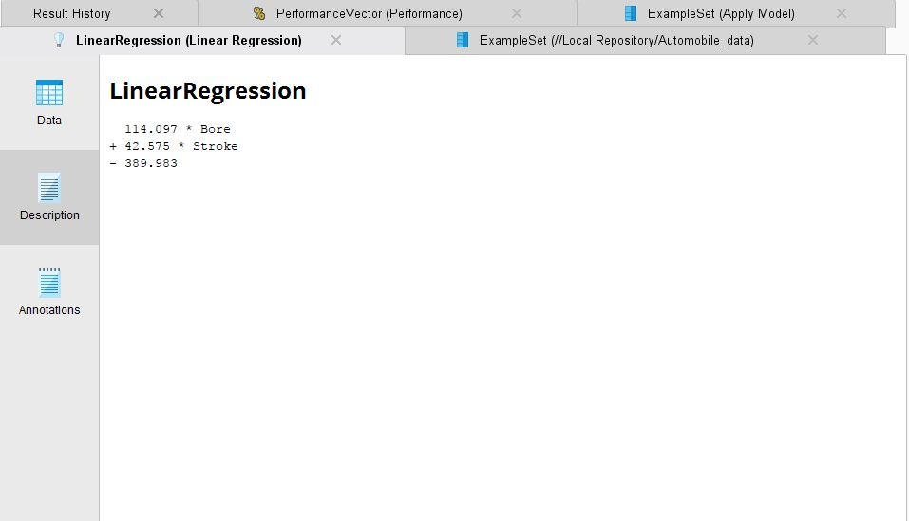

Slide 16
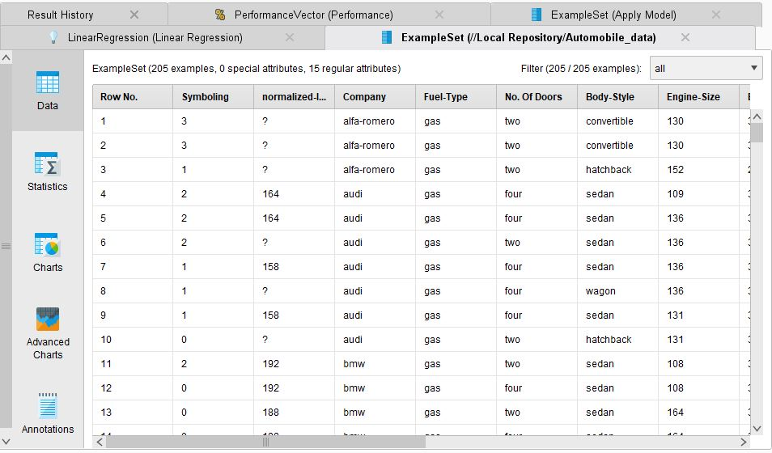

Slide 17
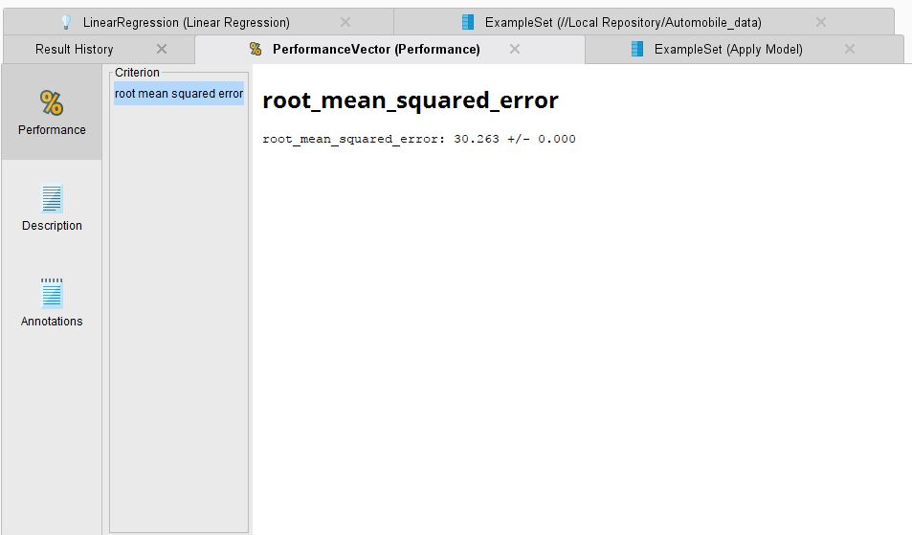

Slide 18
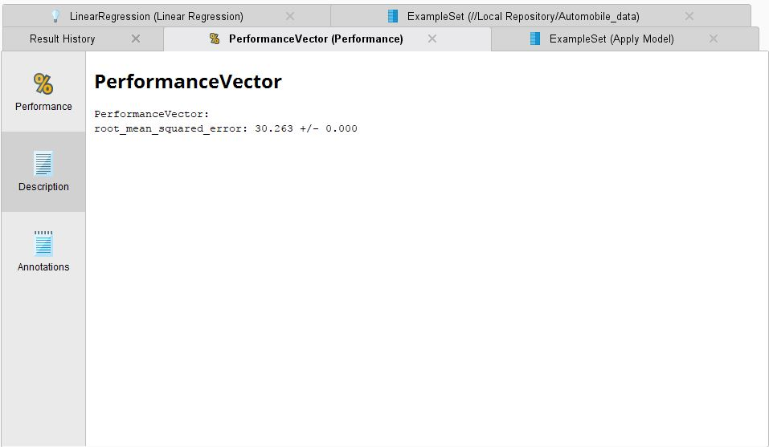

Slide 19
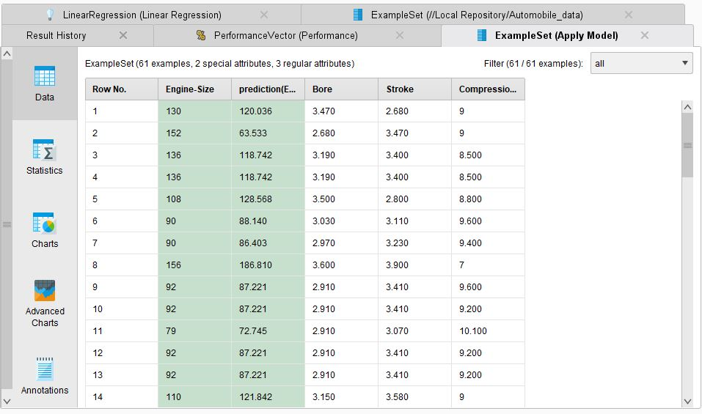

Slide 20
Thank You

